Slide 1
Klasifikasi Objek pada Koridor Gedung Pascasarjana PENS
Anggota Kelompok:
1123800010 Ahmada Haiz Zakiyil Ilahi
1123800012 Zulfikar Davbi Mahendra F
1222800008 Achmad Torikul Huda
1222800012 Rudi Kurniawan

Slide 2
Objek yang diklasifikasi:
Koridor
Pintu darurat
Pintu ruangan
Lift
Tangga

Slide 3
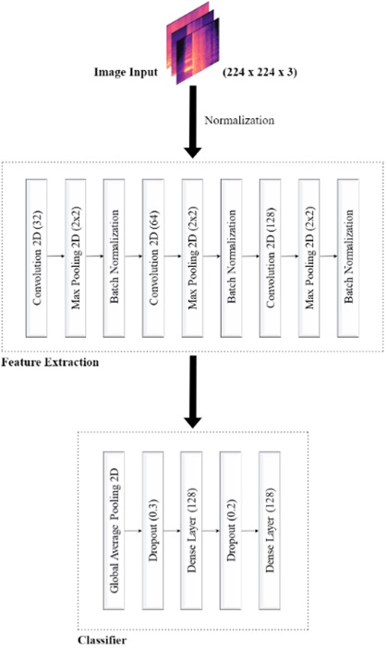
Arsitektur

Slide 4
Data Preprocessing
# initial parameters
epochs = 100
batch_size = 32
input_size = (224,224)
# image augmentation part
train_datagen = ImageDataGenerator(rescale = 1./255,
rotation_range=40,
shear_range = 0.2,
zoom_range = 0.2,
horizontal_flip = True,
brightness_range=[0.2,1.0],
fill_mode='nearest')
test_datagen = ImageDataGenerator(rescale = 1./255)
STEP_SIZE_TRAIN=training_set.n//training_set.batch_size
STEP_SIZE_VALID=val_set.n//val_set.batch_size
STEP_SIZE_TEST=test_set.n//test_set.batch_size

Slide 5
Data Preprocessing
Conv2D(128, kernel_size=(3, 3), strides=(1, 1), padding='same'),
BatchNormalization(),
Activation('relu'),
Conv2D(128, kernel_size=(3, 3), strides=(1, 1), padding='same'),
BatchNormalization(),
Activation('relu'),
MaxPooling2D(pool_size=(2, 2), strides=(2, 2)),
Dropout(0.25),
GlobalAveragePooling2D(),
Dense(256, activation='relu'),
BatchNormalization(),
Dropout(0.5),
Dense(128, activation='relu'),
BatchNormalization(),
Dropout(0.5),
Dense(5, activation='softmax')
])
model.summary()
model = Sequential([
Input(shape=(*input_size, 3)),
Conv2D(32, kernel_size=(3, 3), strides=(1, 1), padding='same'),
BatchNormalization(),
Activation('relu'),
MaxPooling2D(pool_size=(2, 2), strides=(2, 2)),
Dropout(0.25),
Conv2D(64, kernel_size=(3, 3), strides=(1, 1), padding='same'),
BatchNormalization(),
Activation('relu'),
Conv2D(64, kernel_size=(3, 3), strides=(1, 1), padding='same'),
BatchNormalization(),
Activation('relu'),
MaxPooling2D(pool_size=(2, 2), strides=(2, 2)),
Dropout(0.25),
Conv2D(128, kernel_size=(3, 3), strides=(1, 1), padding='same'),
BatchNormalization(),
Activation('relu'),

Slide 6
Model Compilation
#Optimizer Adam
opt = tf.keras.optimizers.Adam(learning_rate=0.001)
#Compiling the model
model.compile(optimizer=opt, loss='categorical_crossentropy', metrics=['accuracy'])
early_stop = EarlyStopping(monitor='val_loss', patience=100, restore_best_weights=True)
checkpoint = ModelCheckpoint("/content/drive/MyDrive/pasca_sarjana/computer_vision/project_koridor/model/custom_model.h5", verbose=1, save_best_only=True)

Slide 7
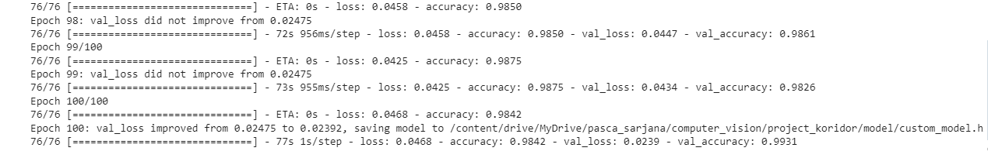
Training Process
# fit the cnn model to the trainig set and testing it on the test set
hist = model.fit_generator(
training_set,
steps_per_epoch=STEP_SIZE_TRAIN,
epochs = epochs,
callbacks=[early_stop, checkpoint],
validation_data=val_set,
validation_steps=STEP_SIZE_VALID)

Slide 8
Performance Analysis
#Getting the accuracy
acc = hist.history['accuracy']
val_acc = hist.history['val_accuracy']
#Getting the losses
loss = hist.history['loss']
val_loss = hist.history['val_loss']
epochs = range(1, len(acc) + 1)
#Plotting Training and Validation accuracy
plt.figure(figsize=(16, 6))
plt.subplot(1, 2, 1)
plt.plot(epochs, acc, '-', label='Training Accuracy')
plt.plot(epochs, val_acc, ':', label='Validation Accuracy')
plt.legend(loc='lower right')
plt.title('Training and Validation Accuracy')
plt.xlabel('Epoch')
plt.ylabel('Accuracy')
#Plotting Training and Validation Loss
plt.subplot(1, 2, 2)
plt.plot(epochs, loss, '-', label='Training Loss')
plt.plot(epochs, val_loss, ':', label='Validation Loss')
plt.legend(loc='upper right')
plt.title('Training and Validation Loss')
plt.xlabel('Epoch')
plt.ylabel('Loss')
plt.show()

Slide 9
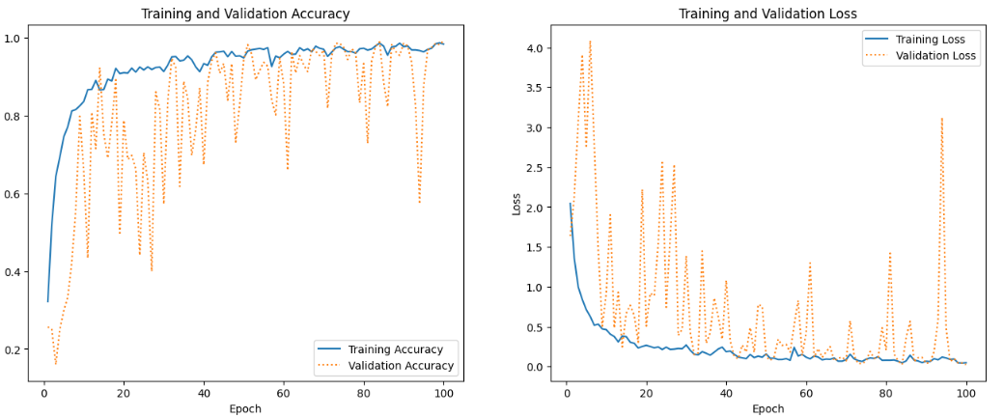
Performance Analysis

Slide 10
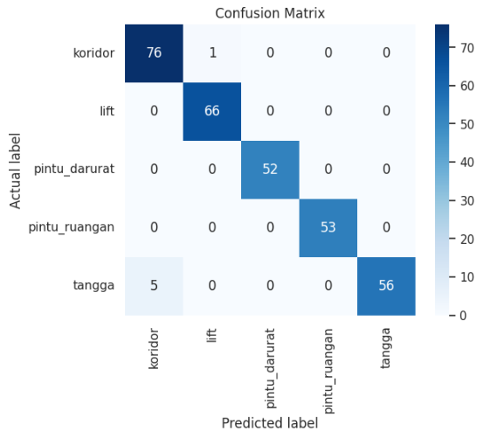
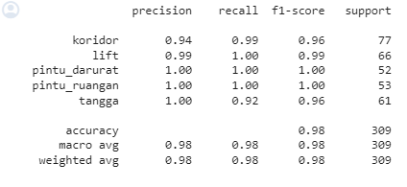
Model Evaluation

Slide 11
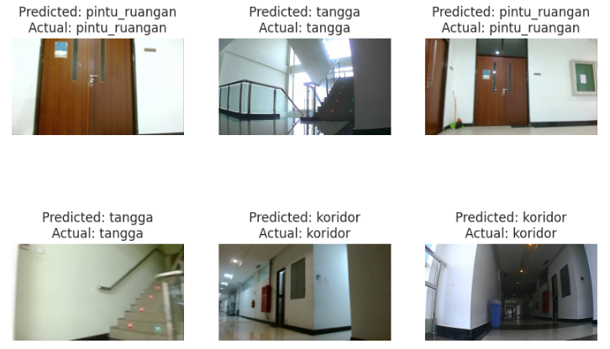
Result

Slide 12
Lampiran
File Program :
https://drive.google.com/drive/folders/1zFRRFU9we_SHYc72MXAxuzHd5yEu1XEJ?usp=drive_link
Link Demo Youtube :
https://youtu.be/oOj6-5BoGnc?si=rkhfMfOM3LCltDv3

